Slide 1
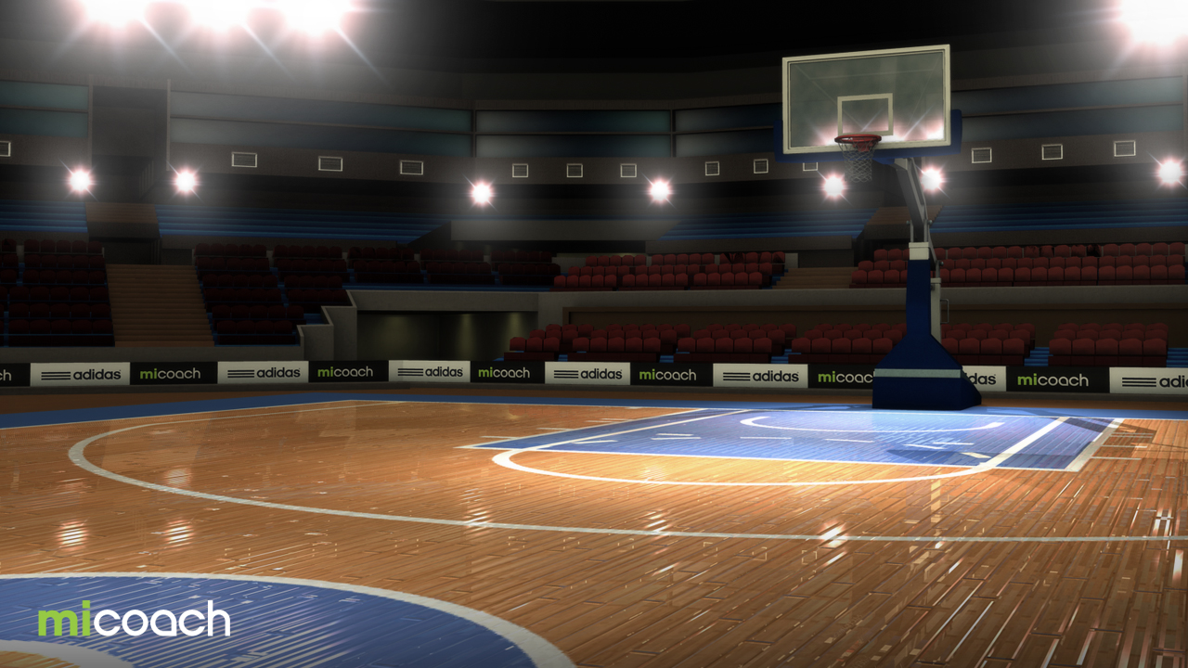
Basketball MoCap Trainer
A collection of UI mockups and overall design choices to show how our technology is intended to be used

Slide 2
A note on Inputs
Our team is still currently deciding between using the Kinect as an input and several cameras, so both cases are described here.

Slide 3
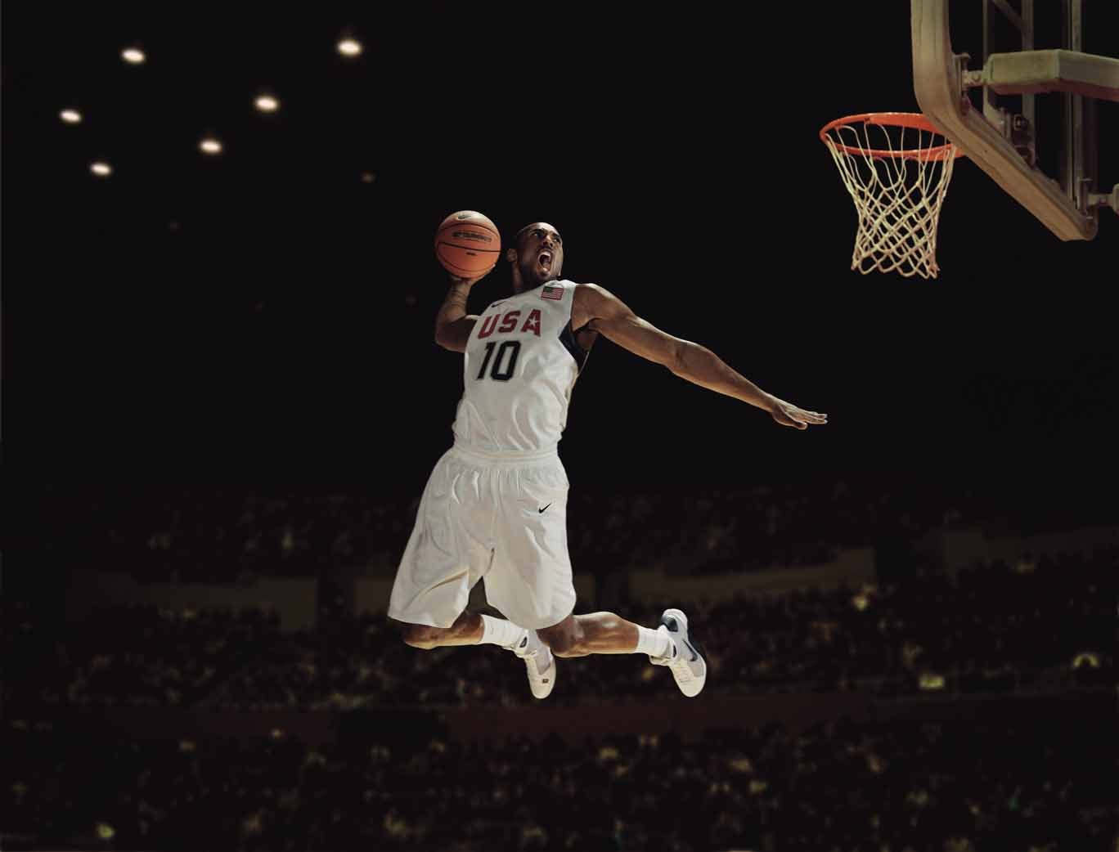
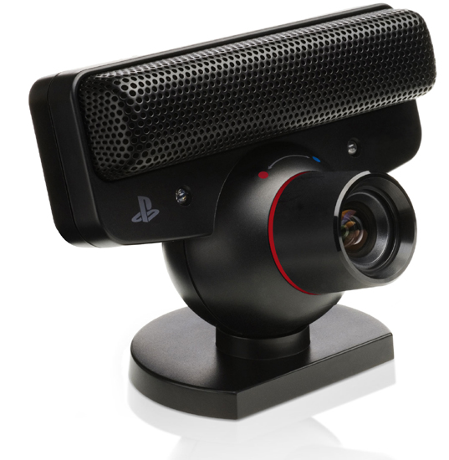
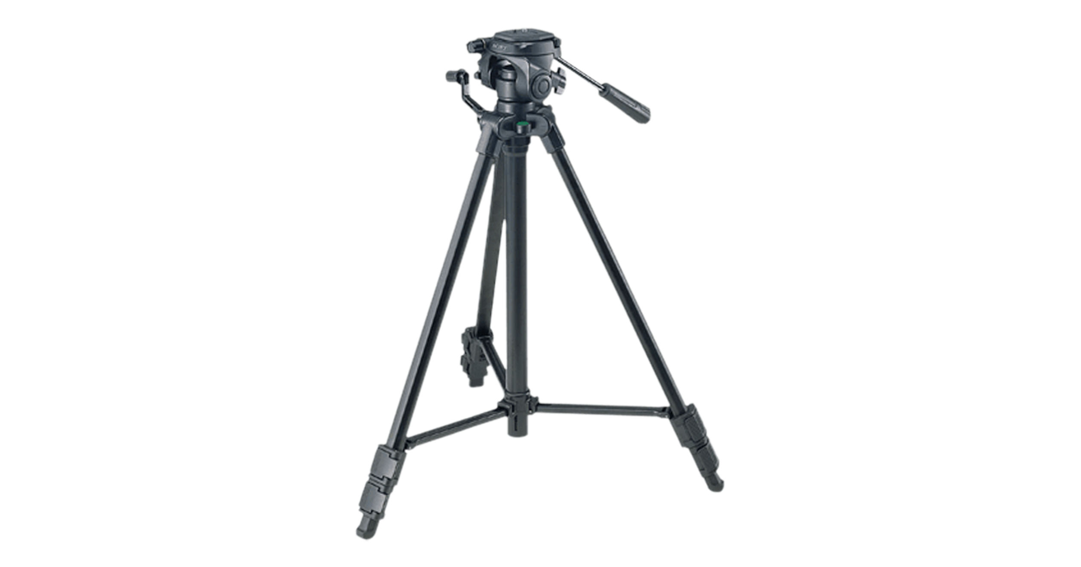
Camera Setup
Three PS Eyes & Motion
Capture

Slide 4
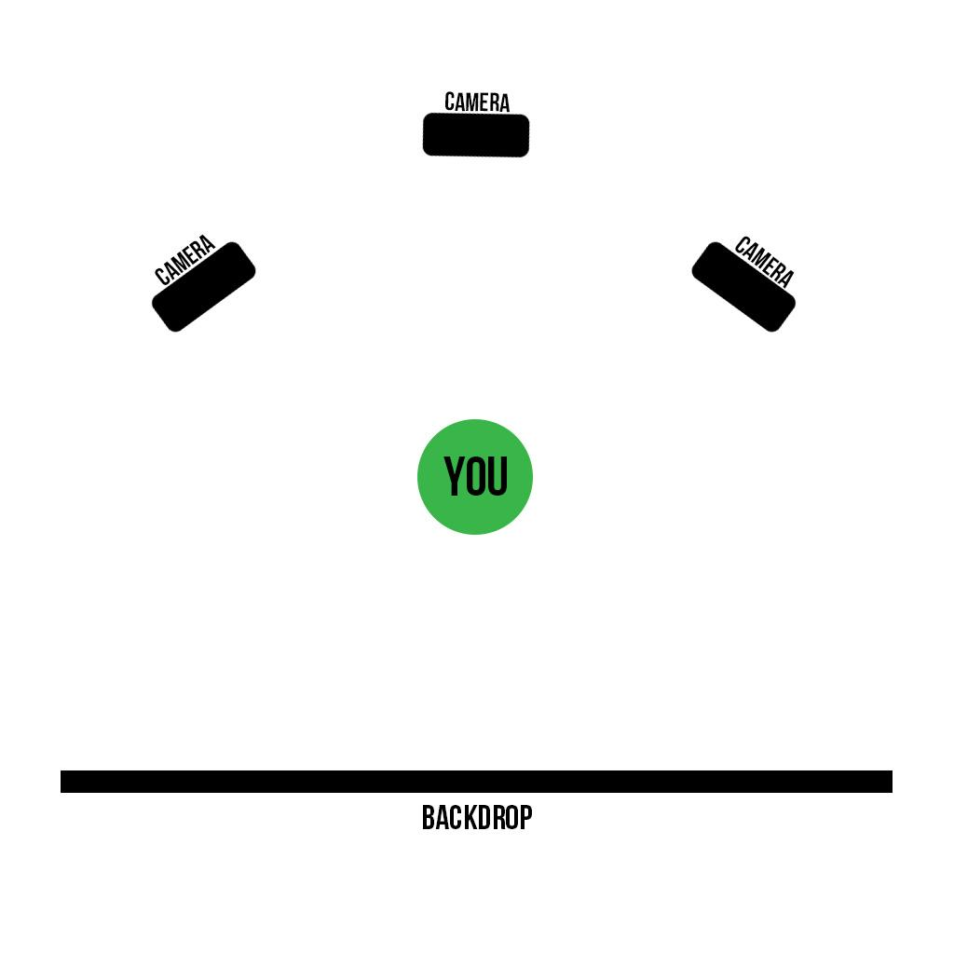

Slide 5
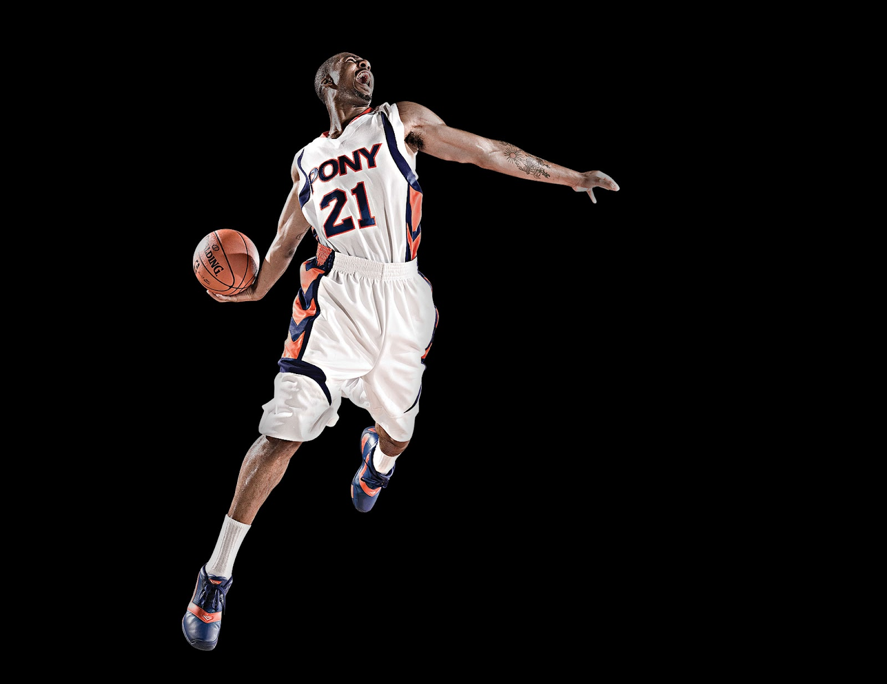
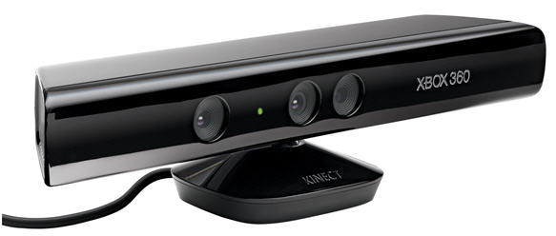
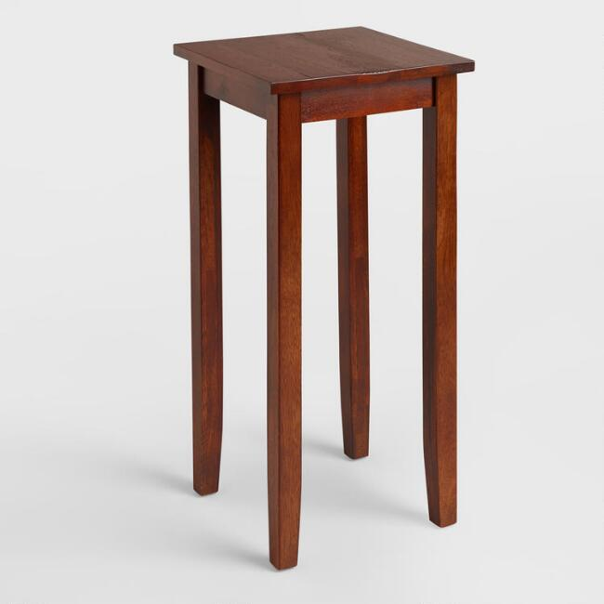
Kinect Setup
One kinect connected
to the DTW model and
user interface.

Slide 6
A note on micro:bits
While micro:bits are not a part of our minimum viable product, we would still like to incorporate them into future iterations and, as such, they are inluded here.

Slide 7
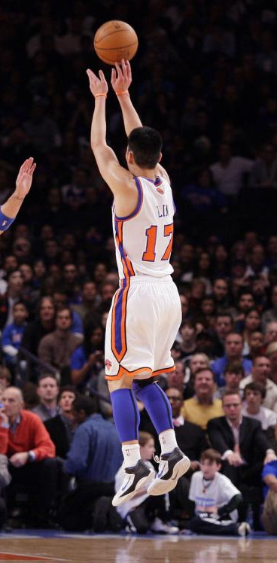
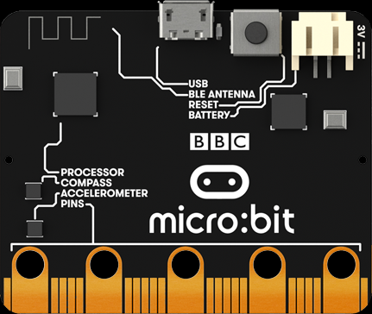
Microbit use (for more precise tracking)
One microbit strapped to each wrist, streaming wirelessly

Slide 8
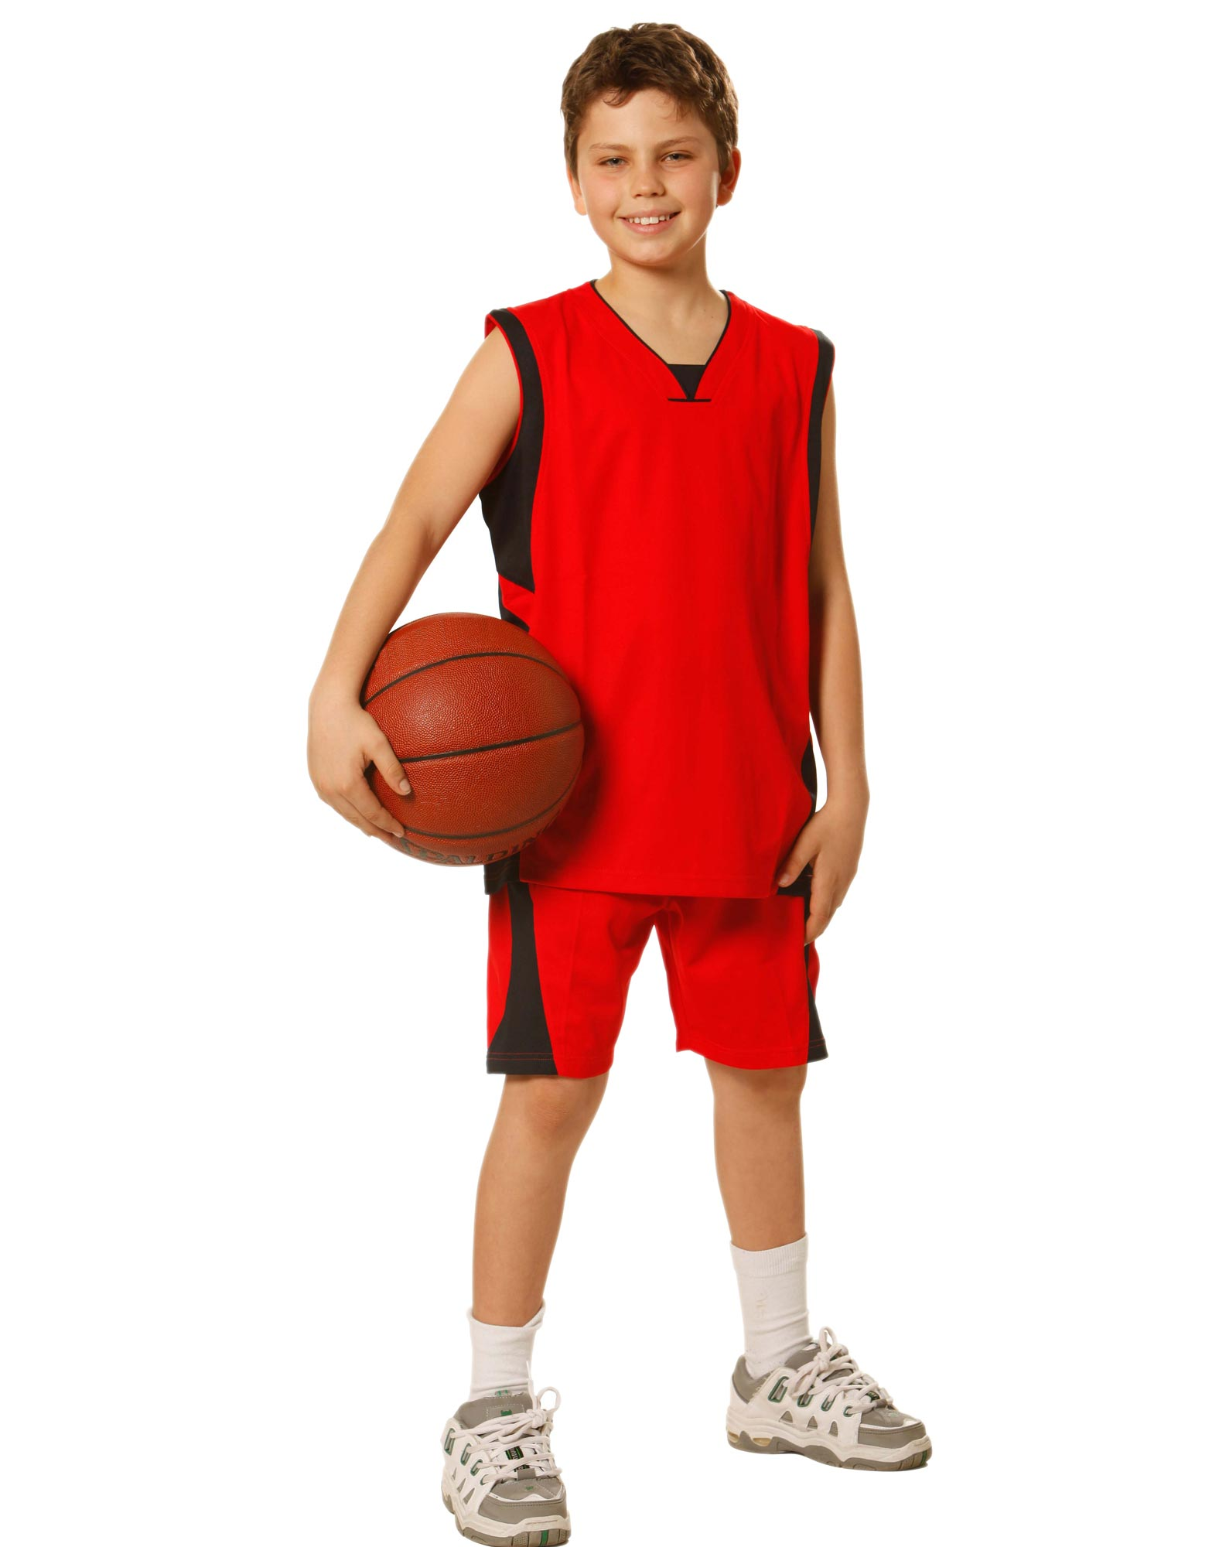
Use by Clients
While the coach is there, they will teach correct form. With motion cap, that form will be recorded and fed to ML Algorithms

Slide 9
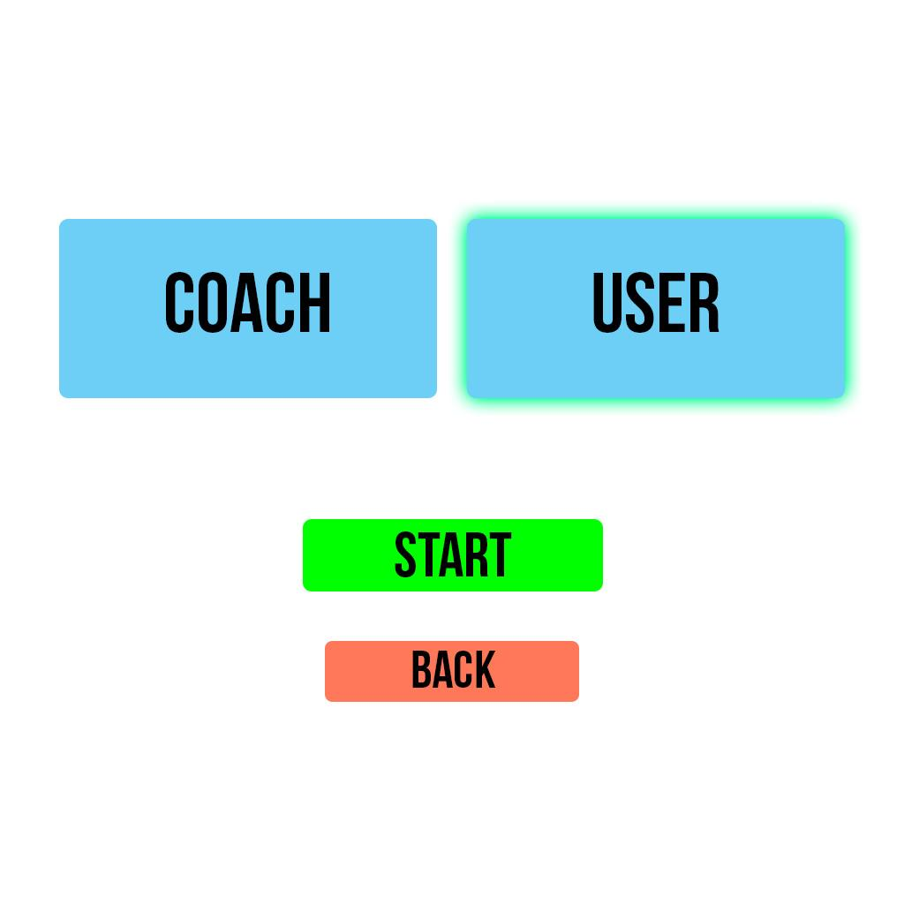
*Sketch of the initial startup screen, in which the user will choose whether they are with a coach for training or by themselves.

Slide 10
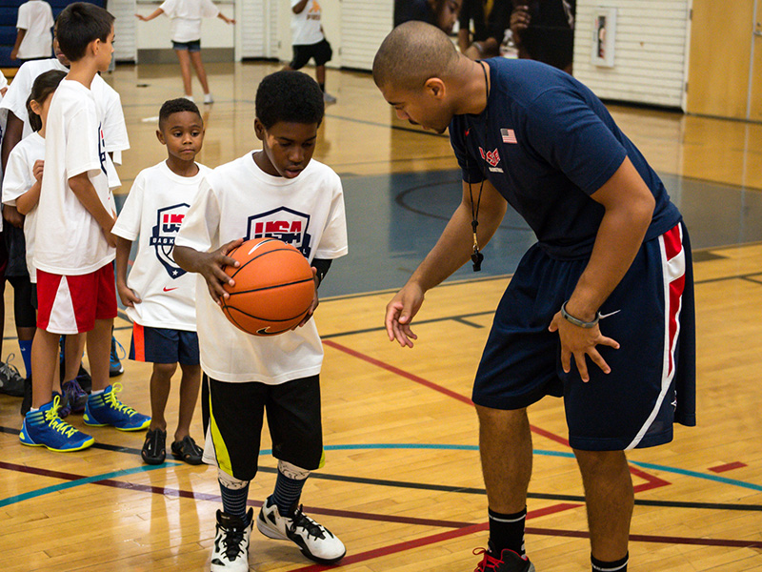
In coaching mode, the coach chooses the player’s best motions, and the ML algorithm considers those chosen body movements to be the standard to train the classifier with

Slide 11
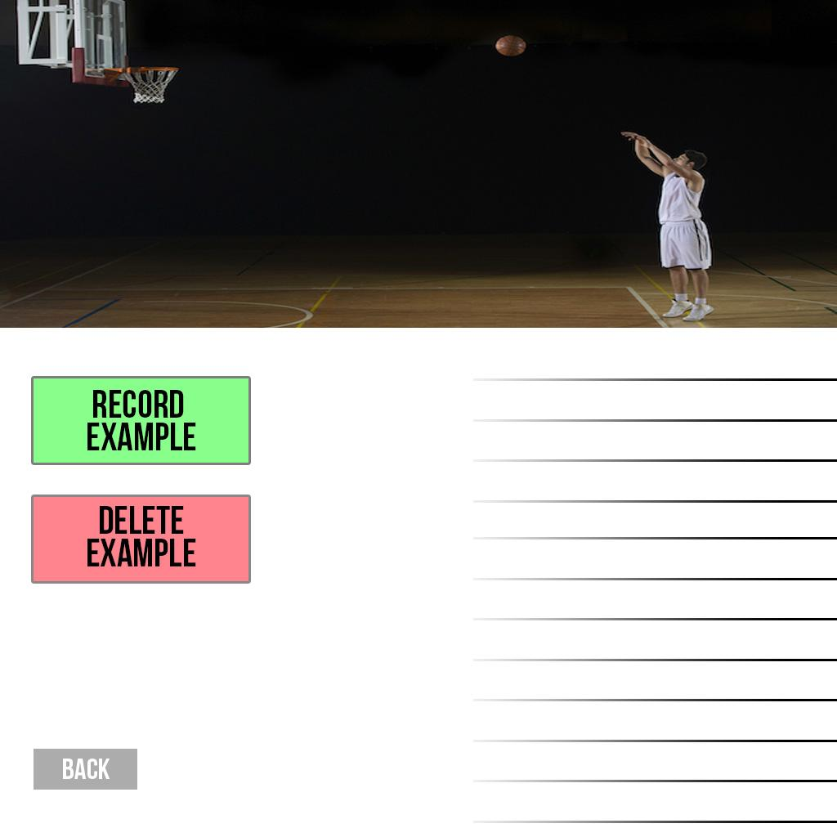
*Sketch of the coach input screen, in which the coach can choose to keep or throw away certain examples of their user.

Slide 12
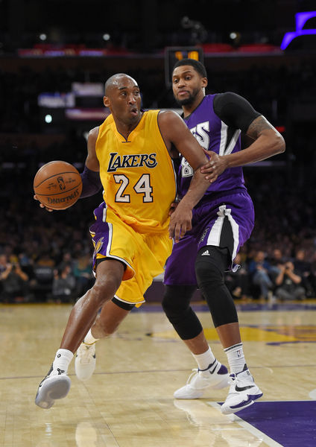
If time and money allows, also have professionals come into the studio, and record their motions. Then, users can train on their own milestones, as well as compare to professional movements

